Slide 1


Exposure Java 2013
APCS Edition
Chapter 17 Slides
Input/Output with Sequential Files
PowerPoint Presentation
created by:
Mr. John L. M. Schram
and Mr. Leon Schram
Authors of Exposure Java

Slide 2
Section 17.1
Introduction

Slide 3
Programs & Data Files Notes
Data information processed by word processing, spreadsheet or other application programs are stored as data files.
Java programs, written with a text editor or some Integrated Development Environment (IDE), are also data files.
Programs have the capability to create and retrieve their own data files.
This means that data entered in any one of your programs can be saved for later use.
Programs can be tested with existing data files for greater efficiency.

Slide 4
AP Exam Alert
The material presented in this chapter will not be tested on the AP Computer Science Examination, precisely because of the large variety of approaches that can be used to achieve similar input/output goals.

Slide 5
Data Organization
bit | This is the fundamental building block of all computer information, a binary digit, which stores only 1 or 0.
byte | One byte equals 8 bits. One character can be stored in one byte, using ASCII code. One character is stored in two bytes using Unicode.
field | A field is one specific unit of information of one data type, such as size, age, name, date, etc.
record | A record consists of a set of fields for some specific purpose, such as a student record, a medical record, an employee record, an airline passenger record, etc.
file | A file is a sequence of records of the same type.

Slide 6
Section 17.2
Different Types
of Files

Slide 7
File Definition
A file is a sequence of information stored as bytes on a disk, tape, CD or other external storage device.

Slide 8
Sequential Access & Random Access
Files can have sequential access or random access.
Sequential access files allow data access only in the sequence that the data is stored in the file.
Random access files allow data access in any random pattern, regardless of how the data is stored.

Slide 9
Sequential Access Examples

Slide 10
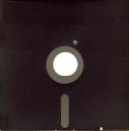

Random Access Examples

Slide 11
Text Files and Binary Files
Files are either Text Files or Binary Files.
Text Files store a series of characters and can be read or edited by any text editor like Notepad or JCreator. All java programs are text files.
Binary Files have a special format that can only be read by a certain piece of software.
Examples:
.doc files require Word
.xls files require Excel
.ppt files require PowerPoint
In this class, we will be working with Sequential Text files only!

Slide 12
Section 17.3
Using the
File class

Slide 13
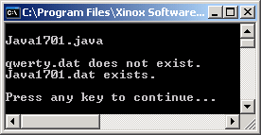
// Java1701.java
// This program demonstrates how to check if an external text file exists
// using the <getName> and <exists> methods of the <File> class.
import java.io.*;
public class Java1701
{
public static void main (String args[])
{
File file1 = new File("qwerty.dat"); // #1
System.out.print(file1.getName()); // #2
if (file1.exists()) // #3
System.out.println(" exists.");
else
System.out.println(" does not exist.");
File file2 = new File("Java1701.dat");
System.out.print(file2.getName());
if (file2.exists())
System.out.println(" exists.\n");
else
System.out.println(" does not exist.\n");
}
}

Slide 14
File Methods getName & exists
File f = new File("test.dat");
String s = f.getName();
Method getName returns file name "test.dat".
if (f.exists())
Method exists returns true if "test.dat" exists,
and returns false if the file does not exist.

Slide 15
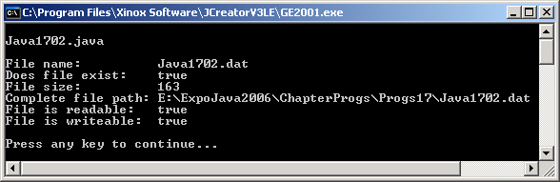
// Java1702.java
// This program demonstrates the <getName>, <exist>, <length>,
// <getAbsolutePath>, <canRead> and <canWrite> methods of the File class.
import java.io.*;
public class Java1702
{
public static void main (String args[])
{
File f = new File("Java1702.dat");
System.out.println("File name: " + f.getName());
System.out.println("Does file exist: " + f.exists());
System.out.println("File size: " + f.length());
System.out.println("Complete file path: " + f.getAbsolutePath());
System.out.println("File is readable: " + f.canRead());
System.out.println("File is writeable: " + f.canWrite());
System.out.println();
}
}
NOTE: Your output will be different.
My output looks like this because
I executed this file from my
jump drive back in 2006.

Slide 16
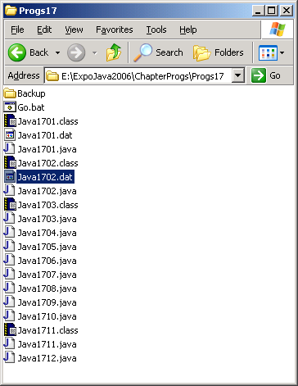
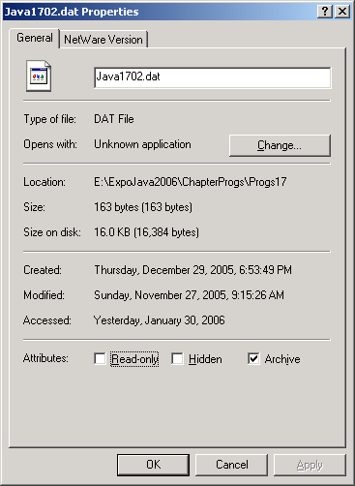
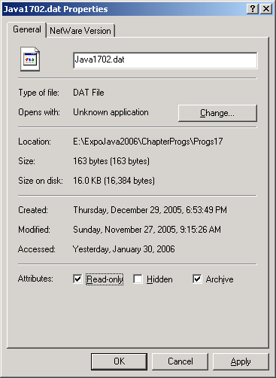
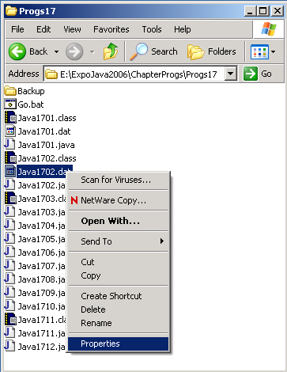
TRY THIS!
Browse to Java1702.dat ; right-click the file name; and chose Properties.
Put a check in the Read-Only box and click OK.
Then re-execute Java1702.java and observe the results.

Slide 17
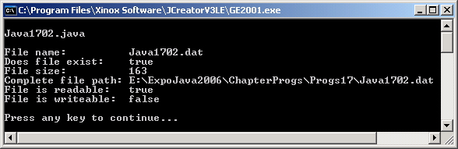
// Java1702.java
// This program demonstrates the <getName>, <exist>, <length>,
// <getAbsolutePath>, <canRead> and <canWrite> methods of the File class.
import java.io.*;
public class Java1702
{
public static void main (String args[])
{
File f = new File("Java1702.dat");
System.out.println("File name: " + f.getName());
System.out.println("Does file exist: " + f.exists());
System.out.println("File size: " + f.length());
System.out.println("Complete file path: " + f.getAbsolutePath());
System.out.println("File is readable: " + f.canRead());
System.out.println("File is writeable: " + f.canWrite());
System.out.println();
}
}
Now that the file is read-only,
this output has changed.

Slide 18
File Methods length, getAbsolutePath, canRead & canWrite
int n = f.length(); Method length returns the size of f.
String p = f.getAbsolutePath(); Method getAbsolutePath returns the complete path from root to the file directory of f.
boolean canIt = f.canRead(); Method canRead returns true if f is readable.
boolean canIt = f.canWrite(); Method canWrite returns true if f is writeable.

Slide 19
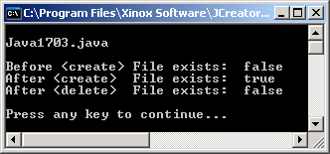
// Java1703.java
// This program demonstrates creating and deleting files with the
// <delete> and <createNewFile> methods.
import java.io.*;
public class Java1703
{
public static void main (String args[]) throws IOException
{
System.out.println("\nJava1703.java\n");
File f = new File("Java1703.dat");
System.out.println("Before <create> File exists: " + f.exists());
f.createNewFile();
System.out.println("After <create> File exists: " + f.exists());
f.delete();
System.out.println("After <delete> File exists: " + f.exists());
System.out.println();
}
}

Slide 20
File Methods delete & createNewFile
f.delete();
Method delete removes the external file associated with f.
f.createNewFile();
Method createNewFile creates a new, but empty file.

Slide 21
Special Note on Program Output for this Chapter
Since this chapter deals with files, the programs can send output both to the monitor and to a text file.
The monitor output will be shown in the actual DOS window as always.
The text file output will be shown in a Notepad window.
(The actual text file will be loaded in notepad to view its contents. It could also have been loaded in Jcreator. )

Slide 22
Section 17.4
Files of
Character Strings

Slide 23

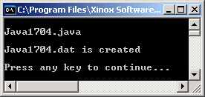
// Java1704.java
// This program demonstrates how to create textfiles with the
// <FileWriter> class, <BufferedWriter> class and the <write> method.
import java.io.*;
public class Java1704
{
public static void main (String args[]) throws IOException
{
FileWriter outFile = new FileWriter("Java1704.dat"); // #1
BufferedWriter outStream = new BufferedWriter(outFile); // #2
String outString = "Too bad Java has so few I/O classes"; // #3
outStream.write(outString); // #4
outStream.close(); // #5
System.out.println("Java1704.dat is created\n"); // #6
}
}

Slide 24
What is throws IOException?
You will notice that the main method in all of these programs has the following heading:
Java is a – for lack of a better word – a paranoid language.
It is not only concerned with what is wrong with a program,
it is also concerned with what might go wrong.
When working with files, there are many things that can go wrong!
Java expects you to deal with all of these possible exceptions.
If you don’t want to mess with them (and we don’t) you put
throws IOException in the heading of any method
(not just the main method) that uses file handling.
public static void main (String args[]) throws IOException
{

Slide 25

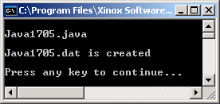
// Java1705.java
// This program is identical to Java1704.java with the <FileWriter> class
// and <BufferedWriter> class statements combined in one statement.
import java.io.*;
public class Java1705
{
public static void main (String args[]) throws IOException
{
BufferedWriter outStream =
new BufferedWriter(new FileWriter("Java1705.dat"));
String outString = "Too bad Java has so few I/O classes";
outStream.write(outString);
outStream.close();
System.out.println("Java1705.dat is created\n");
}
}

Slide 26
FileWriter & BufferedWriter Classes
The FileWriter class is used to transfer character-oriented data from internal memory to an external file.
The BufferedWriter class manages line-oriented data.
Together these two classes enable you to transfer line-oriented character strings.
FileWriter outFile = new FileWriter("Java1705.dat");
BufferedWriter outStream = new BufferedWriter(outFile);

Slide 27
Anonymous Objects
In Java1705.java the following single statement is used.
BufferedWriter outStream =
new BufferedWriter(new FileWriter("Java1705.dat"));
Note that the previous outFile object is no longer used, but there is a new BufferedWriter object, which requires an object.
An object, without a name, is created by
new FileWriter("Java1705.dat")
This object without an identifying name is called an anonymous object.

Slide 28
Reading from
a File

Slide 29

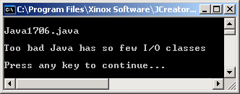
// Java1706.java
// This program demonstrates how to retrieve textfiles with the <FileReader> class, <BufferedReader> class and the <read> method.
// This program will retrieve the textfiles created by the Java1705.java.
import java.io.*;
public class Java1706
{
public static void main (String args[]) throws IOException
{
FileReader inFile = new FileReader("Java1705.dat"); // #1
BufferedReader inStream = new BufferedReader(inFile); // #2
String inString = inStream.readLine(); // #3
System.out.println(inString); // #4
inStream.close(); // #5
System.out.println();
}
}
Created by the last program

Slide 30
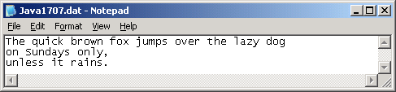

// Java1707.java
// This program demonstrates how to create a multi-line textfile
// separated with the <newLine> method.
import java.io.*;
public class Java1707
{
public static void main (String args[]) throws IOException
{
BufferedWriter outStream =
new BufferedWriter(new FileWriter("Java1707.dat")); // #1
outStream.write("The quick brown "); // #2
outStream.write("fox jumps over the lazy dog"); // #3
outStream.newLine(); // #4
outStream.write("on Sundays only,"); // #5
outStream.newLine(); // #6
outStream.write("unless it rains."); // #7
outStream.close(); // #8
System.out.println("Java1707.dat is created\n"); // #9
}
}

Slide 31
BufferedWriter Methods write, newLine, & close
outStream.write("Grace Hopper is my hero"); Method write transfers character stream data from internal memory to external storage.
outStream.newLine(); Method newLine adds an end-of-line character to the external file. The result is that the next data will be stored on a new line in the text file.
outStream.close(); Method close concludes the output stream processing.

Slide 32

// Java1708.java
// This program reads in the entire Java1707.dat or any other text file, line by line.
// Additionally a <Scanner> object to enter a file name during program execution.
import java.io.*;
import java.util.Scanner;
public class Java1708
{
public static void main (String args[]) throws IOException
{
System.out.println("\nJava1708.java\n");
Scanner keyboard = new Scanner(System.in);
System.out.print("Enter an external file name ===>> ");
File inFile = new File(keyboard.nextLine());
if (inFile.exists())
{
BufferedReader inStream =
new BufferedReader(new FileReader(inFile)); // #1
String inString; // #2
while((inString = inStream.readLine()) != null) // #3
System.out.println(inString); // #4
inStream.close();
}
else
{
System.out.println("Specified file does not exist.");
System.out.println("Program aborted.");
}
System.out.println();
}
}
Created by the last program

Slide 33
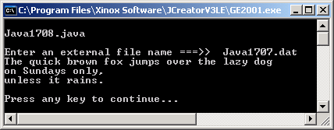
Java1708.java Output #1

Slide 34
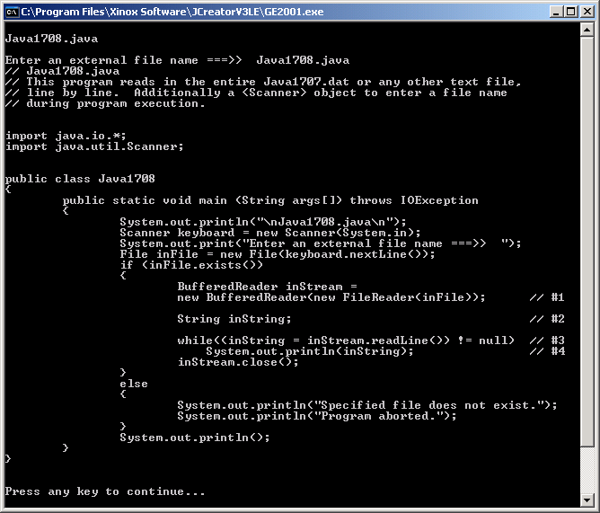
Java1708.java Output #2

Slide 35
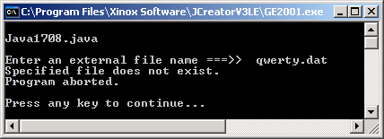
Java1708.java Output #3

Slide 36
FileReader & BufferedReader Classes
The FileReader class is used to transfer character-oriented data from an external file to internal memory.
The BufferedReader class manages line-oriented data.
Together these two classes enable you to transfer line-oriented character strings.
FileReader inFile = new FileReader("Java1707.dat");
BufferedReader inStream = new BufferedReader(inFile);
These two statements can be wrapped together into a single statement with the same result.
BufferedReader inStream = new BufferedReader(new FileReader(inFile));

Slide 37
BufferedReader Methods readLine & close
inString = inStream.readLine();
Method readLine transfers one complete line of characters, including the end-of-line character, from external storage to internal memory.
inStream.close();
Method close concludes the input stream processing.

Slide 38
Computer Science
Commandment
Anything that thou openst
-- be it a (, a [, a {, or a FILE --
thou shalt also closeth!

Slide 39
Section 17.5
Files of
Numbers

Slide 40
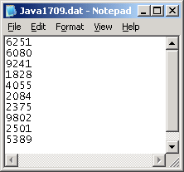

// Java1709.java
// This program generates a text file of 10 random integers.
// Each integer is converted with the <String.valueOf> method
// to a string before the number is transferred to the OutputStream.
import java.io.*;
import java.util.Random;
public class Java1709
{
public static void main (String args[]) throws IOException
{
Random rand = new Random(12345);
BufferedWriter outStream =
new BufferedWriter(new FileWriter("Java1709.dat")); // #1
int rndInt; // #2
for (int k = 1; k <= 10; k++) // #3
{
rndInt = rand.nextInt(9000) + 1000; // #4
outStream.write(String.valueOf(rndInt)); // #5
outStream.newLine(); // #6
}
outStream.close(); // #7
System.out.println("Java1709.dat is created\n"); // #8
}
}

Slide 41
// Java1709.java
// This program generates a text file of 10 random integers.
// Each integer is converted with the <String.valueOf> method
// to a string before the number is transferred to the OutputStream.
import java.io.*;
import java.util.Random;
public class Java1709
{
public static void main (String args[]) throws IOException
{
Random rand = new Random(12345);
BufferedWriter outStream =
new BufferedWriter(new FileWriter("Java1709.dat")); // #1
int rndInt; // #2
for (int k = 1; k <= 10; k++) // #3
{
rndInt = rand.nextInt(9000) + 1000; // #4
outStream.write(String.valueOf(rndInt)); // #5
outStream.newLine(); // #6
}
outStream.close(); // #7
System.out.println("Java1709.dat is created\n"); // #8
}
}
Why is the newLine command necessary for this program?

Slide 42
String Method valueOf
String s = String.valueOf(intNumber);
Static method valueOf converts intNumber to a String object.
This is not a file class method, but you need to use this method to store numerical values.

Slide 43
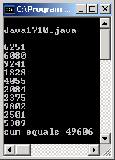
// Java1710.java
// This program retrieves the random integer textfile created by program Java1709.java.
// The stored character strings are converted back to integers. The integer value of the
// integers is computed and displayed to prove that the values are in fact integers.
import java.io.*;
public class Java1710
{
public static void main (String args[]) throws IOException
{
System.out.println("\nJava1710.java\n");
BufferedReader inStream =
new BufferedReader(new FileReader("Java1709.dat")); // #1
String inString; // #2
int rndInt; // #3
int sum = 0; // #4
while((inString = inStream.readLine()) != null) // #5
{
System.out.println(inString); // #6
rndInt = Integer.parseInt(inString); // #7
sum += rndInt; // #8
}
inStream.close(); // #9
System.out.println("sum equals " + sum); // #10
System.out.println();
}
}
Created by
the last
program

Slide 44
Integer Method parseInt
rndInt = Integer.parseInt(inString);
Static method parseInt converts inString to an integer value.
This is not a file class method, but you need to use this method to convert numerical character values back to integers.

Slide 45
Double Method parseDouble
gpa = Double.parseDouble(input.readLine());
Static method parseDouble converts the anonymous String object to a double value.
This is not a file class method, but you need to use this method to convert numerical character values back to doubles.

Slide 46
Section 17.6
A Note About
The Scanner Class

Slide 47
Special Note on The Last 2 Programs
It is possible to use the combination of the BufferedReader and InputStreamReader classes for keyboard input.
This actually is how older Exposure Java editions presented keyboard input before we had the Scanner class. Two more programs will be shown.
The first will review input with the Scanner class.
The final program will have the same output, but use will demonstrate how to use the combination of the BufferedReader and InputStreamReader classes for keyboard input.
Note that this form of input (as with most forms of input in Java) only can enter a String. The parseInt and parseDouble methods are necessary in this program for conversion.

Slide 48
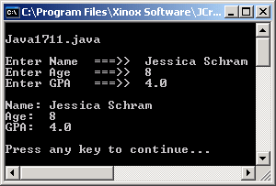
// Java1711.java
// This program reviews some of the methods used by the <Scanner> class.
import java.util.Scanner;
public class Java1711
{
public static void main (String args[])
{
System.out.println("\nJava1711.java\n");
Scanner input = new Scanner(System.in);
String name;
int age;
double gpa;
System.out.print("Enter Name ===>> ");
name = input.nextLine();
System.out.print("Enter Age ===>> ");
age = input.nextInt();
System.out.print("Enter GPA ===>> ");
gpa = input.nextDouble();
System.out.println();
System.out.println("Name: " + name);
System.out.println("Age: " + age);
System.out.println("GPA: " + gpa);
System.out.println();
}
}

Slide 49

// Java1712.java
// This program shows how BufferedReader and InputStreamReader can be used for
// keyboard input.
import java.io.*;
public class Java1712
{
public static void main (String args[]) throws IOException
{
System.out.println("\nJava1712.java\n");
BufferedReader input = new BufferedReader(new InputStreamReader(System.in));
String name; int age; double gpa;
System.out.print("Enter Name ===>> ");
name = input.readLine();
System.out.print("Enter Age ===>> ");
age = Integer.parseInt(input.readLine());
System.out.print("Enter GPA ===>> ");
gpa = Double.parseDouble(input.readLine());
System.out.println();
System.out.println("Name: " + name);
System.out.println("Age: " + age);
System.out.println("GPA: " + gpa);
System.out.println();
}
}

